Slide 1
Practical Data Science Research
Dr. Erik Hemberg, Research Scientist, ALFA Group, MIT CSAIL

Slide 2
Agenda
Introduction
Setup and configuration
Data Science Research – Online Learning
Data Description
Data set creation
Data set modelling
Data Science Research – Neuro Science
Summary

Slide 3
Learning Objective for Practical Data Science Seminar
Prepare for the demands of the program by:
Increase Practical Data Science expertise
Increase Data Science Skills
Reflection and discussion on Data Science with peers
Engagement with peers in the Data Science course
Common language, processes and tools
Awareness of Research applications of Data Science

Slide 4
What is the role of the participant in the Practical Data Science Seminar?
We believe you have a strong influence on our way forward to applying data science for research
We hope you want to share your experiences, build on other´s experiences and together explore new learnings
We will count on your feedback to further develop and improve the practical data science seminar

Slide 5
Practical Workshop Requirements
Internet connection for source files
https://github.com/ALFA-group/CoLAB-Workshop-2019
There is also a release https://github.com/ALFA-group/CoLAB-Workshop-2019/releases
Note: Use git for version control
Computer
0.5 GB free on HD for data set
Software
Python >=3.6
Jupyter >= 4.4
Scikit Learn, Pandas, Matplotlib, Seaborn, SciPy, Numpy

Slide 6
Data Download
Download
https://analyse.kmi.open.ac.uk/open_dataset#data
Unzip the downloaded file `vle_data.zp`
Move the extracted `*.csv` files to the `data` folder of the downloaded repository

Slide 7
Seminar Interaction
Share via e.g.
git, e.g. fork or clone the repository https://github.com/ALFA-group/CoLAB-Workshop-2019
Link to shared document, e.g. GoogleDocs

Slide 8
Data Science Components
Visualize
Data
Preprocess
Feature Creation
Model

Slide 9
MOOC Research with Data Science
Massive Open Online Course (MOOC)
10,000 students
Open Registration
Fixed start/end dates
$50 for a certificate
MOOC is different from a traditional learning environment.
Notes:
% MOOC, familiar with -> however, highlight several features that make it fundamentally different
% 1. hundreds of thousands of students enrolling the course -> enough training data to build machine learning models, especially neural network approach
% 2. open registration lead to more diverse background -> algorithm bias?
% 3. students have more of flexibility of choosing how to pace through the course. While there are several deadlines, self-paced, and lots of dropouts
MOOCs can have many flavors
We are interested here in large, open, affordable with fixed progression.
A key challenge is the variability of the students

Slide 10
What is the “doer effect?”
The “doer effect” is an association between the number of online interactive practice activities students do and their learning outcomes
Koedinger, Kenneth R., et al. “Is the doer effect a casual relationship?: how can we tell and why it’s important.” Proceedings of the Sixth International Conference on Learning Analytics & Knowledge. ACM, 2016.

Slide 11
Doer Effect Study
Classify Course Materials by Type
Videos: lectures
Finger exercises: optional problems between lectures video segments, reveal-solution and check-answer options
Assessments:
Exams – a midterm and a final
Problem sets – required problems; 6.00.1x has six; 6.00.2x has four
Formulate Research Questions
Develop mixed and fixed effect (factor) regressions
Isolation of main and interactive effects
Explore features of increasing granularity
How Student Background and Topic Impact the Doer Effect in Computational Thinking MOOCs Maiyuran, Jitesh; Bajwa, Ayesha; Bell, Ana; Hemberg, Erik; O'Reilly, Una-May, LWMOOCS 2019, In Submission

Slide 12
What is Data?
A table, each column is a feature based on the properties of the data and each row has the values of a data example
Data types
Structured, Unstructured
Numerical, Categorical
Linked, Unlinked
Common assumptions
No missing values
No errors
Type
Value
Index/Column | Name | Height
1 | Alice | 160
2 | Bob | 170
3 | Carol | 175

Slide 13
What is Science?
For practice lets focus on a scientific method:
Research question (What do we want to answer)
Observation (What do we see)
Hypothesis formulation (Why do we see this)
Experimental testing (Can we verify our claims)
Replicable
Analysis (What did the tests say)
Does this work in practice for Data Science?

Slide 14
What is a Data Scientist?
Draw your self as a data scientist

Slide 15
Working with data
What does the data look like? E.g.
Shape
Size
Values
What are the assumptions regarding the data? E.g.
Distribution
Noise
Representative
What are important features? E.g.
Value ranges
What is the bias of the model?

Slide 16
Some tips to do and do not – Suggestions?
Consistent and structured format for output and names
Automating data and log handling
Sensible naming
Revise and refactor
Enough documentation
“intuitive” structure is important
Small end-to-end version (agile enough)
Small chunks (of everything)
Clean environments: Virtual machines, containers, virtual environments
“It works on my machine…”
Curse of defaults. Then you might not know what you have done.
Corrupt or delete all data? Be specific about input and output folders
Try to back up data (but it is difficult when data is large and distant and not under your control)
Notebooks works but can get “complex”, i.e. when there is not too much “programming”
Pair programming (collaboration and sharing)
Data science is not solved, but there are tools that make it easier, key is right tool for the job so you can work efficiently:
Version control: Git
IDE & Editor: PyCharm, Emacs
Terminal: tmux
`bash` can be useful “glue” for automation
API documentation, StackOverflow, “Web search”
Galleries for visualization
Cheat Sheets:
Python:
https://ehmatthes.github.io/pcc/cheatsheets/README.html
https://perso.limsi.fr/pointal/_media/python:cours:mementopython3-english.pdf
Pandas:
https://github.com/pandas-dev/pandas/blob/master/doc/cheatsheet/Pandas_Cheat_Sheet.pdf
Static analysis: Black, flake
Your debugging can be someone else learning tool

Slide 17
Notes regarding the seminar
There is a lot to cover, so we will not be able to cover all, focus is on overview and practice
Not expected to know everything before or even directly after
Prepare for what to come at the course and baseline your practical knowledge
Identify what is easy and hard
If you do not know, follow the instructions and instructor
If you do know then work on your own by asking a research question, explore and share your findings
The point of the notebook is to expand and elaborate

Slide 18
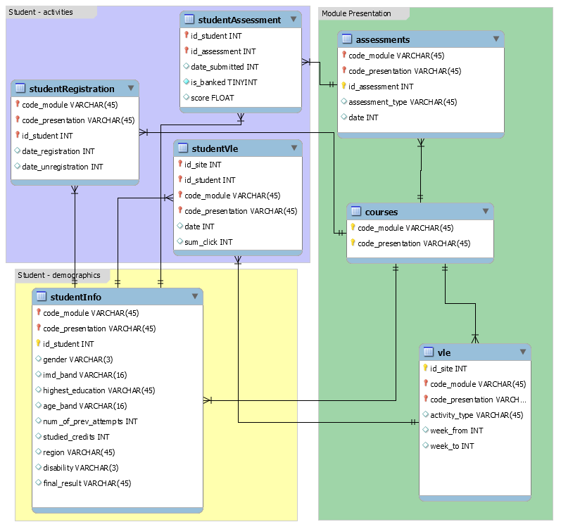
Data Science Research in Practice
https://analyse.kmi.open.ac.uk/open_dataset#about
Kuzilek J., Hlosta M., Zdrahal Z. Open University Learning Analytics dataset Sci. Data 4:170171 doi: 10.1038/sdata.2017.171 (2017).

Slide 19
Data Description
https://github.com/ALFA-group/CoLAB-Workshop-2019/blob/master/src/data_description.ipynb

Slide 20
Learning Design & Behavior Patterns
Simple representation for when a student accesses what component
Learning behavior patterns – “Bottom-up” from student data
Learning design patterns – “Top-down” from instructional designers
Using Detailed Access Trajectories for Learning Behavior Analysis. Yanbang Wang, Nancy Law, Erik Hemberg, Una-May O'Reilly, International Learning Analytics and Knowledge Conference, 2019

Slide 21
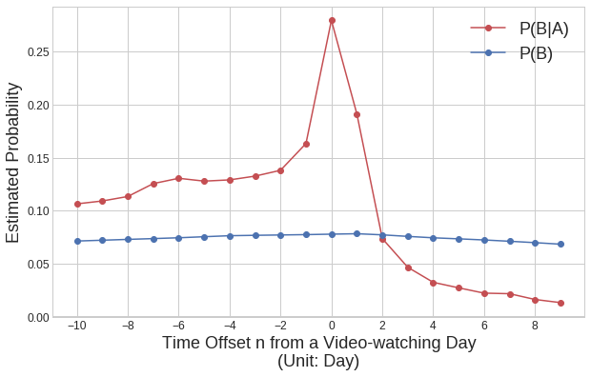
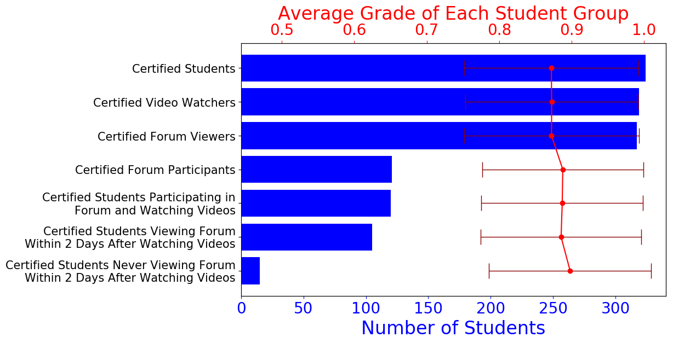
Learning Design Pattern
Learning design has hypothesis regarding efficient learning
Students should participate in forum discussions shortly after they watch a video? (Learning design expert)
How many students exhibit this pattern
What are the grades of students with this pattern?
There are ambiguities in formulating Learning Design Patterns
A: watch at least one video on day x
B: view at least one forum thread on day x+n
Video watching and viewing a forum shortly are dependent, but no grade correlation

Slide 22
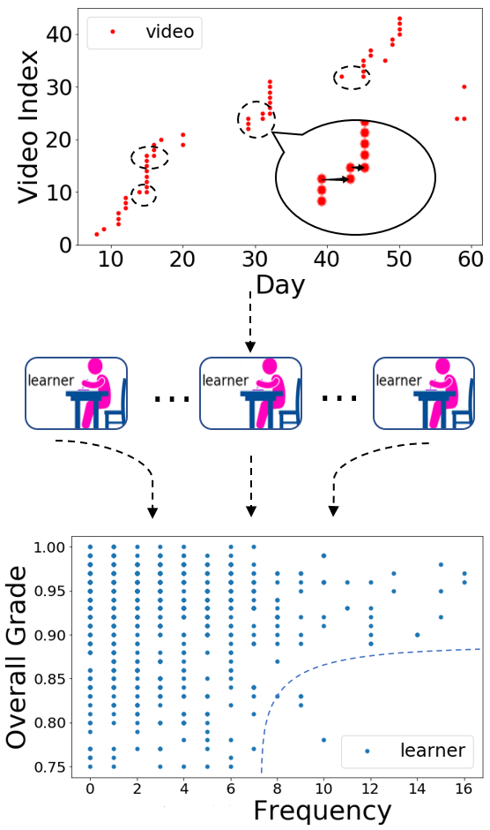
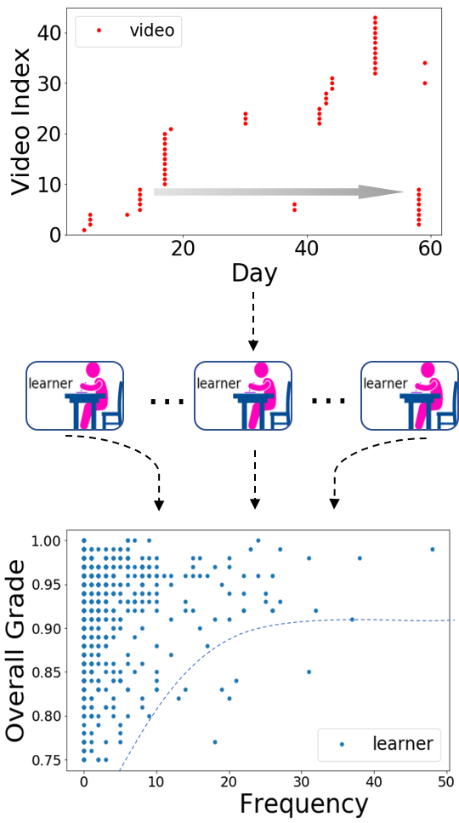
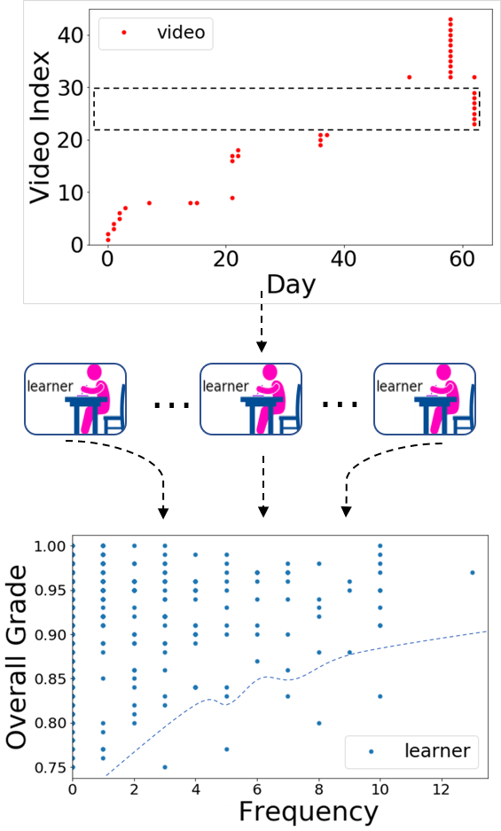
Learning Behavior Patterns – Localized Video Watching
Revising or unfinished?
Realizing videos matter?
Grades are affected by learning behavior patterns

Slide 23
Data Set Creation
https://github.com/ALFA-group/CoLAB-Workshop-2019/blob/master/src/dataset_creation.ipynb

Slide 24
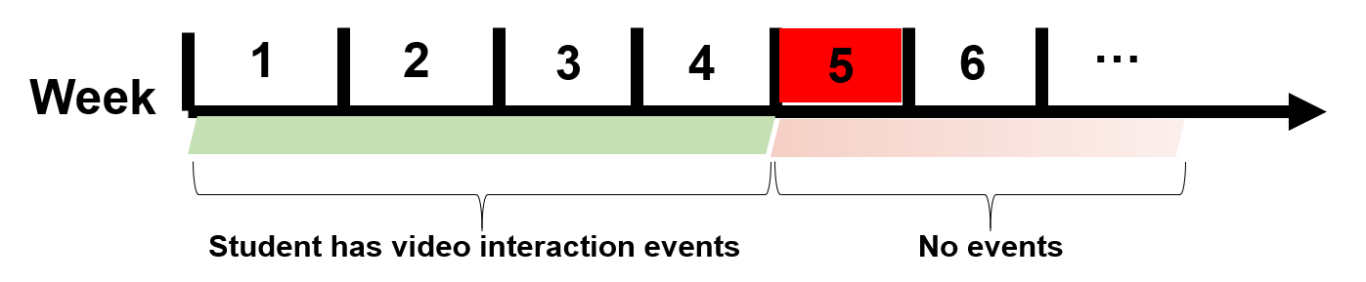
Predicting MOOC Dropout
What is dropout ?
The “dropout week” of a student is defined as the week after the student’s last (video) interaction event. A student’s status is considered “dropped-out” since the dropout week.
dropout week
What is dropout prediction?
To use a student’s data from week 1 to week n to predict whether week (n+1) is the dropout week of that student.
Transfer Learning using Representation Learning in Massive Online Open Courses. John Mucong Ding, Erik Hemberg, Una-May O'Reilly, International Learning Analytics and Knowledge Conference, 2019
Notes:
General understanding
<use the figure to explain dropout week 5>
Why use video
Give two examples of dropout prediction: 1-3 ->4, 1-4 ->5, more later

Slide 25
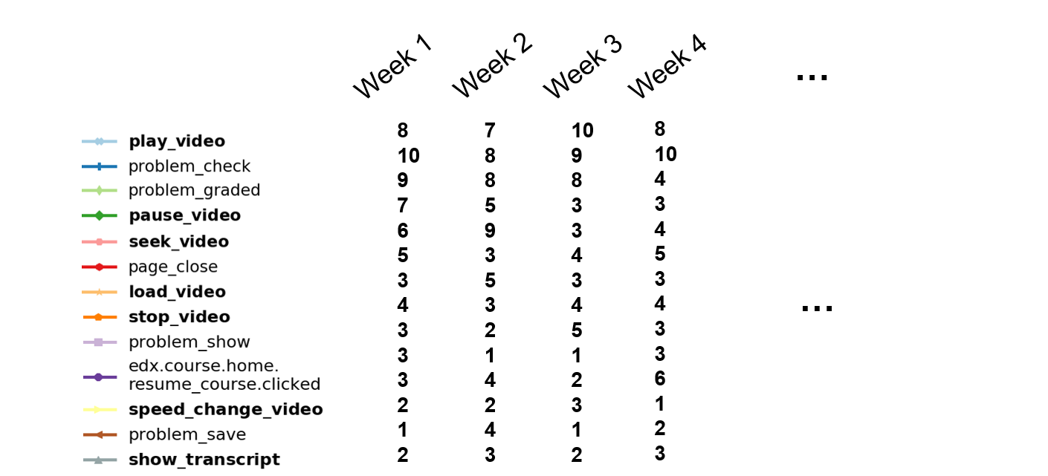
Input: Accumulated Student Event Frequencies Output: Weekly Dropout Label
Notes:
(Follow the animation order)
Use the same dropout sample as used in the previous slide, explain a little
Explain dropout_label
Top 13 most frequent clickstream event type, original categories defined by edx no other manipulation
Matrix of Numbers represents the student’s learning data in terms of frequencies of those ev
Discuss the purple bubbles, train a model for each prediction task

Slide 26
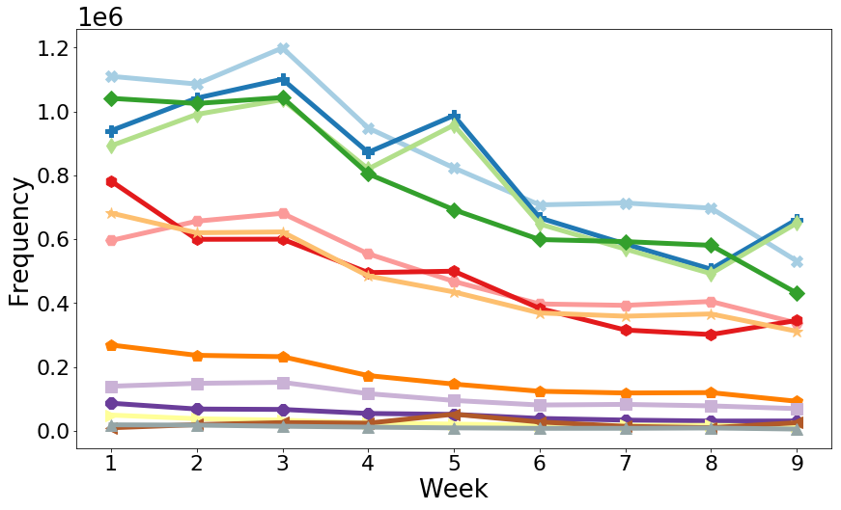
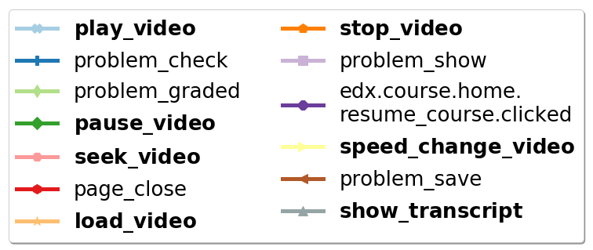
Correlation Among Input Dimensions
Video and problem related events are the most frequent and there exists correlations
Notes:
- Explain the plot means?
- Their frequencies generally decrease along the progression of a course.
- Some events are highly correlated, for example, … so we need to do representation learning, to mention later

Slide 27
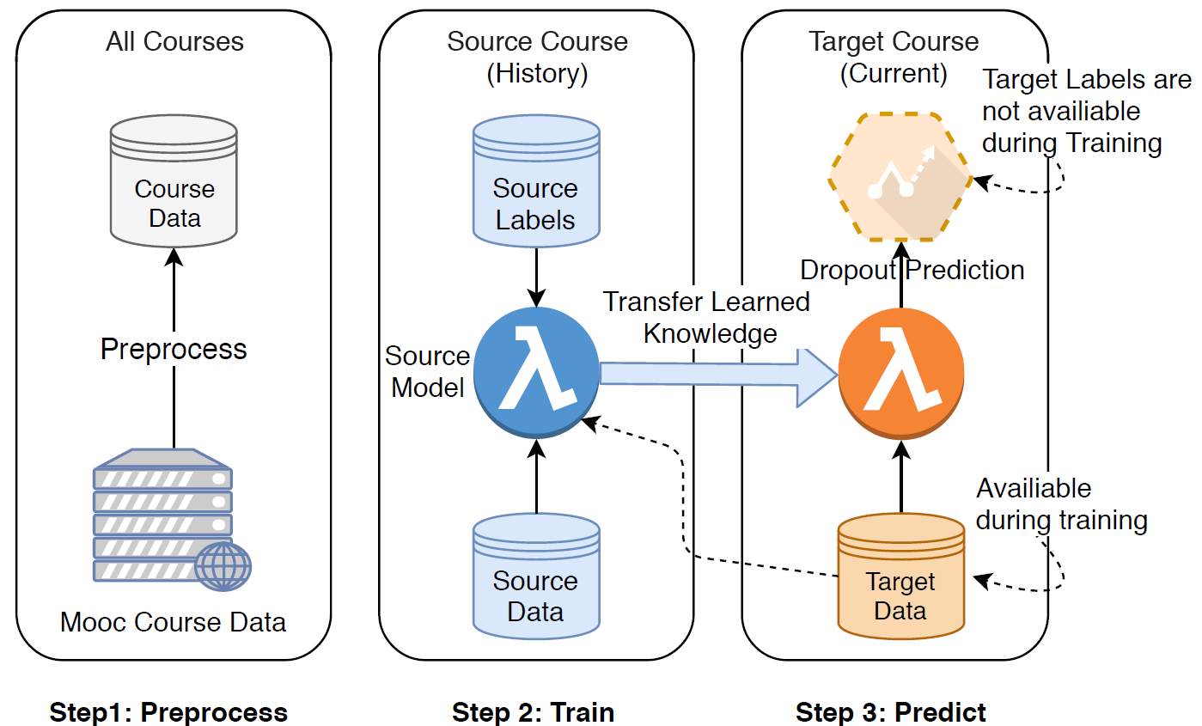
Transductive Transfer Learning
Why transductive transfer learning?
Enable practical training for predicting in an on-going course
Not enough samples to learn from in a small course
A lot of drop out but little data in early weeks
Transductive transfer: no label is available for the target task
Notes:
transit: in order to do the task, we proposed method of traductive transfer learning with representation learning, first what is ttl
Preprocess all the data, including previous course (source) current course (target) +, obtain dataset set of the form just showed you
Final goal is to predict labels in current on-going course, where we don’t have labeled data.
However, no target labels, resort to previous or old courses, where we have complete dataset and call them source data, and train models on source data
However, knowledge not transferrable, so use target data to adapt the source model so that …
Why1: on-going course
Why2: small course
Why3: a lot of drop but little data

Slide 28
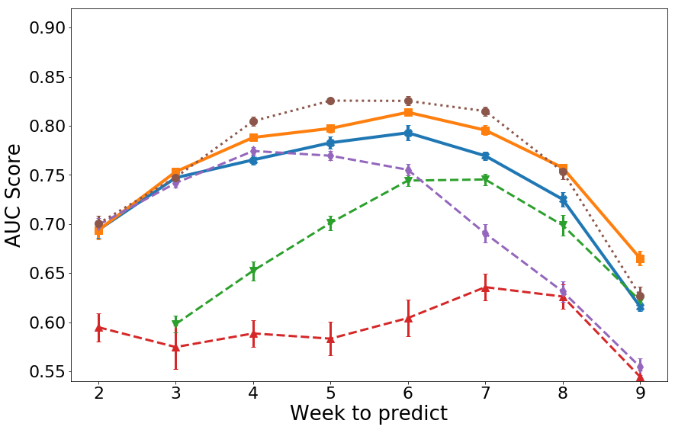
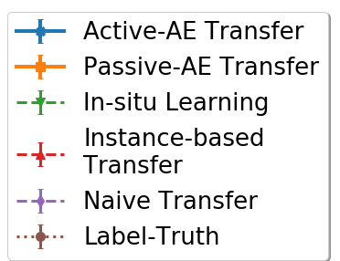
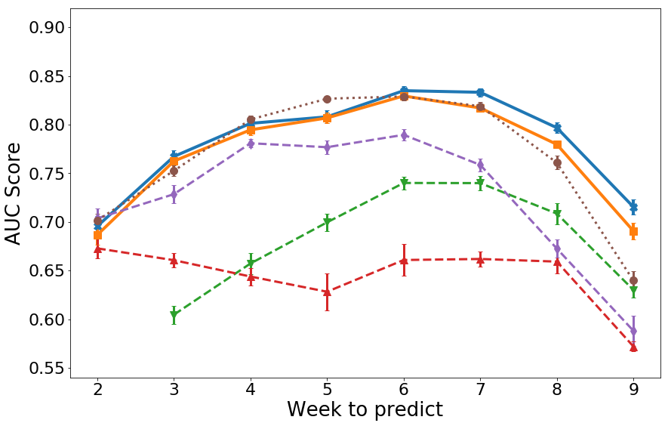
Transfer Learning for Each Week
6.00.2
→
6.00.1
6.00.1
→
6.00.1
Passive and active transfer methods perform well for each week
Notes:
- Visualize the accuracies week by week,
- Active and passive have close performance compared to Label Truth.
- All transfer baselines have significantly lower average AUCs than the Passive-AE Transfer and Active-AE Transfer methods.

Slide 29
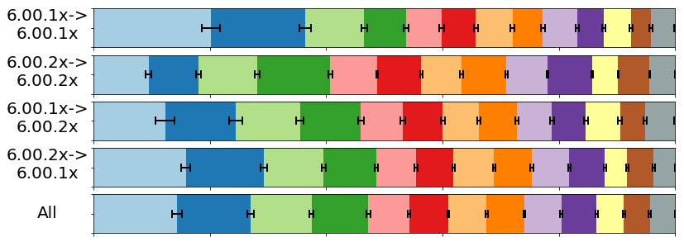
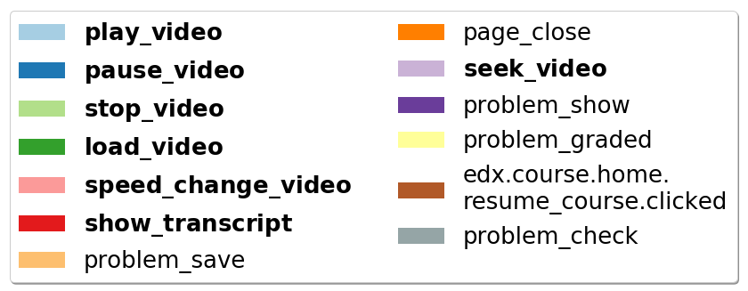
PCA Embedding composition
Weight of PCA scaling factor
Video features have highest weight and are the most transferrable.
Notes:
% IMPORTANT: not very clearly discussed during our meeting, should refer to section 5.5 for correctness.
- Compositions of the embeddings learned by Active-AE Transfer (with error bars) using the neural network implementation of PCA. The legends are ordered with decreasing importance in the average embedding (the last bar).

Slide 30
Data Set Modelling
https://github.com/ALFA-group/CoLAB-Workshop-2019/blob/master/src/dataset_modelling.ipynb

Slide 31
What causes Autism?
A lifelong, neurodevelopmental disorder of social communication and interaction
Highly heritable (60-90%) → genetic causes
Many genes have been identified (35-40% cases)
Many genes critical for communication between brain cells
Less known about possible environmental factors
NOT caused by vaccines
Machine Learning Tools for Analyzing the Development of Neuronal Networks in Health and Disease. Raoul-Emil R. Khouri, Susanna B. Mierau, Przemyslaw Jarzebowski, Ole Paulsen, Erik Hemberg , Una-May O'Reilly. 2nd North East Computational Health Summit AI in Healthcare, 27 April 2018.

Slide 32

From genes to treatments
Genetic causes of human autism
Breed mice with same
genetic cause
Test drug in mice &
humans
Identify drug targets
How does this genetic change disrupt brain function?

Slide 33
Neuro Science Data Science

Slide 34
Detection with sequence labelling

Slide 35
Detector performance
Notes:
Took some time to get the SME to run the GUI…

Slide 36
Communication detection

Slide 37
Results

Slide 38
Summary
Configuration of Data Science environment
Discussions and reflection
Data Science Research Practice
Taste of what to come in 6 months
Write reflections in diary
Google Drive for sharing data scientist drawings:

Slide 39
Acknowledgements
ALFA Group
Una-May O’Reilly
Yanbang Wang
Mucong Ding
Jitesh Maiyran
Ayesha Bajwa
Raoul Khouri
Susanna Mireau
Nancy Law
Ana Bell

